Slide 1
Day 09
Linux Device Driver Training
SEARCHING ALGORITHMS
Presented by,
Ganavi M
Ganavigowda512@gmail.com

Slide 2
SEARCHING
Searching is the process of fetching a specific element in a collection of elements. The collection can be an array or a linked list. If you find the element in the list, the process is considered successful, and it returns the location of that element.
And in contrast, if you do not find the element, it deems the search unsuccessful.
Two prominent search strategies are extensively used to find a specific item on a list. However, the algorithm chosen is determined by the list's organization.
Linear Search
Binary Search

Slide 3
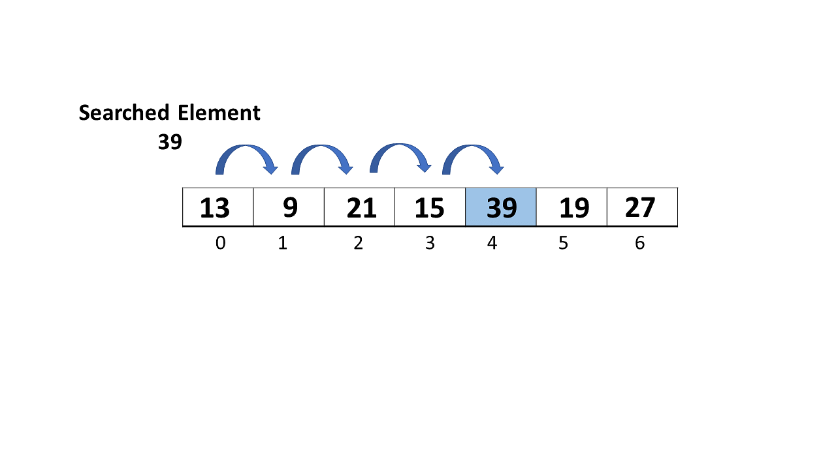
LINEAR SEARCH
Linear search, often known as sequential search, is the most basic search technique. In this type of search, you go through the entire list and try to fetch a match for a single element. If you find a match, then the address of the matching target element is returned.
On the other hand, if the element is not found, then it returns a NULL value.
Following is a step-by-step approach employed to perform Linear Search Algorithm.

Slide 4
Algorithm and Pseudocode of Linear Search Algorithm
Algorithm of the Linear Search Algorithm
Linear Search ( Array Arr, Value a ) // Arr is the name of the array, and a is the searched element.
Step 1: Set i to 0 // i is the index of an array which starts from 0
Step 2: ifi > n then go to step 7 // n is the number of elements in array
Step 3: if Arr[i] = a then go to step 6
Step 4: Set i to i + 1
Step 5: Goto step 2
Step 6: Print element a found at index i and go to step 8
Step 7: Print element not found
Step 8: Exit
Pseudocode of Linear Search Algorithm
Start
linear_search ( Array , value)
For each element in the array
If (searched element == value)
Return's the searched lament location
end if
end for
end

Slide 5
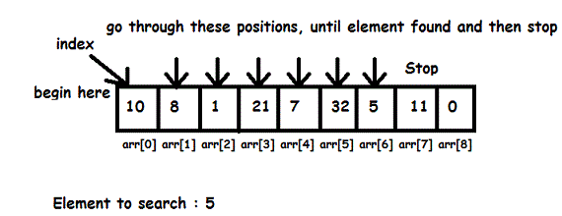
The procedures for implementing linear search are as follows:
Step 1: First, read the search element (Target element) in the array.
Step 2: In the second step compare the search element with the first element in the array.
Step 3: If both are matched, display "Target element is found" and terminate the Linear Search function.
Step 4: If both are not matched, compare the search element with the next element in the array.
Step 5: In this step, repeat steps 3 and 4 until the search (Target) element is compared with the last element of the array.
Step 6 - If the last element in the list does not match, the Linear Search Function will be terminated, and the message "Element is not found" will be displayed.
So far, you have explored the fundamental definition and the working terminology of the Linear Search Algorithm.

Slide 6
BINARY SEARCH
Binary search is the search technique that works efficiently on sorted lists. Hence, to search an element into some list using the binary search technique, we must ensure that the list is sorted.
Binary search follows the divide and conquer approach in which the list is divided into two halves, and the item is compared with the middle element of the list. If the match is found then, the location of the middle element is returned. Otherwise, we search into either of the halves depending upon the result produced through the match.

Slide 7

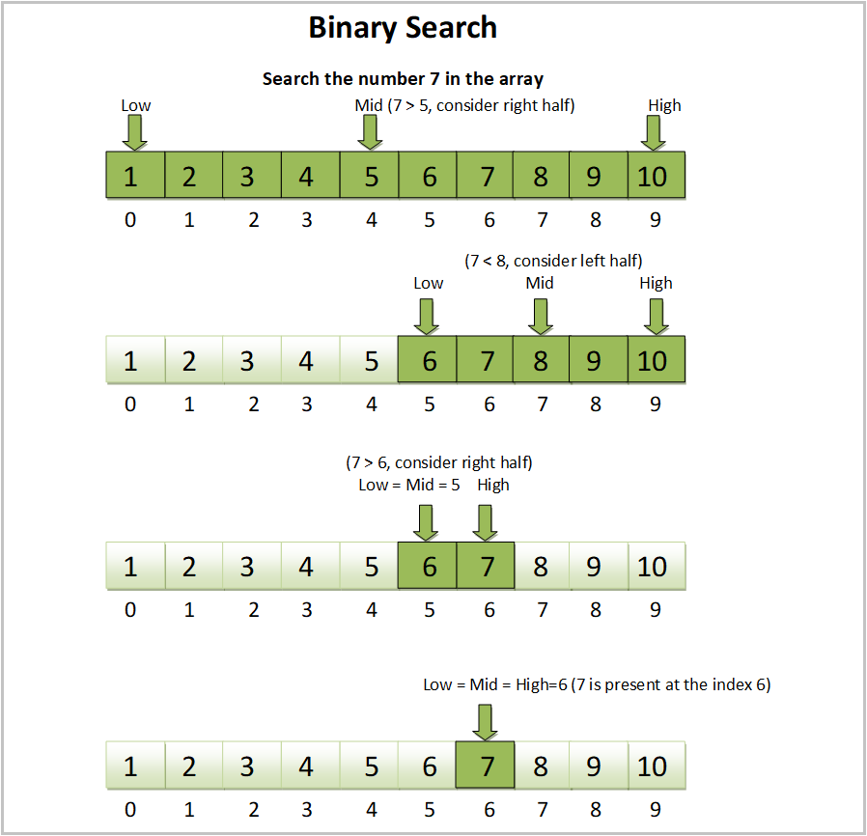

Slide 8
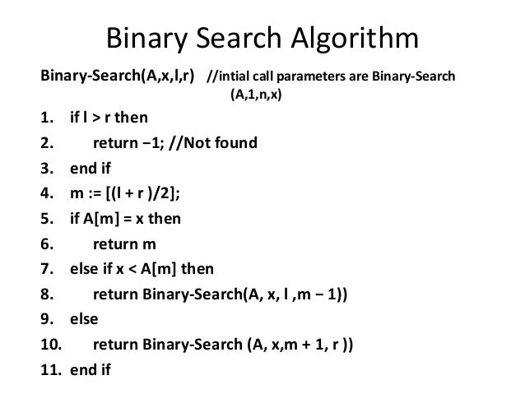

Slide 9
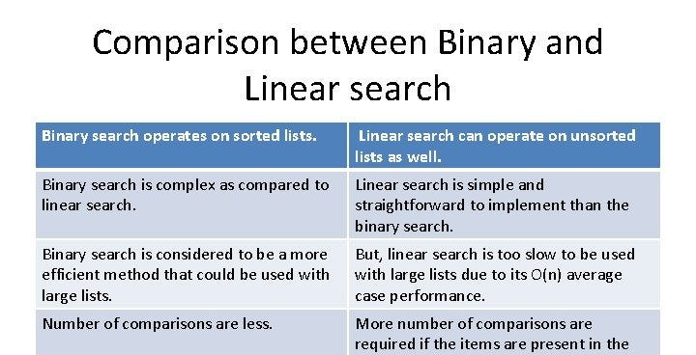

Slide 10
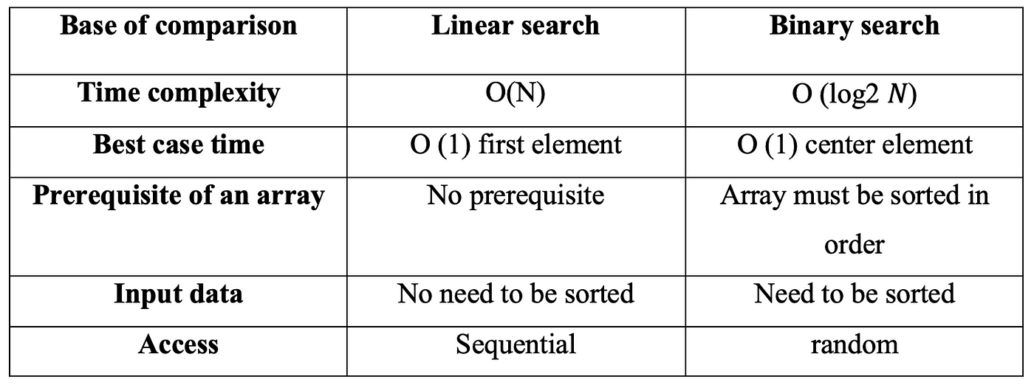

Slide 11
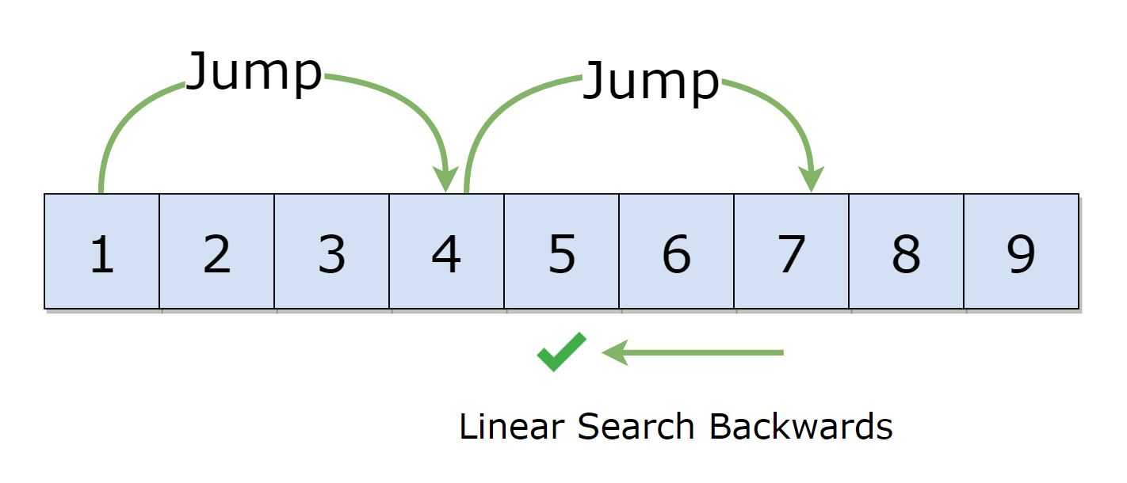
JUMP SEARCH
Jump search technique also works for ordered lists. It creates a block and tries to find the element in that block. If the item is not in the block, it shifts the entire block. The block size is based on the size of the list. If the size of the list is n then block size will be √n. After finding a correct block it finds the item using a linear search technique. The jump search lies between linear search and binary search according to its performance.
The complexity of Jump Search Technique
Time Complexity: O(√n)
Space Complexity: O(1)

Slide 12
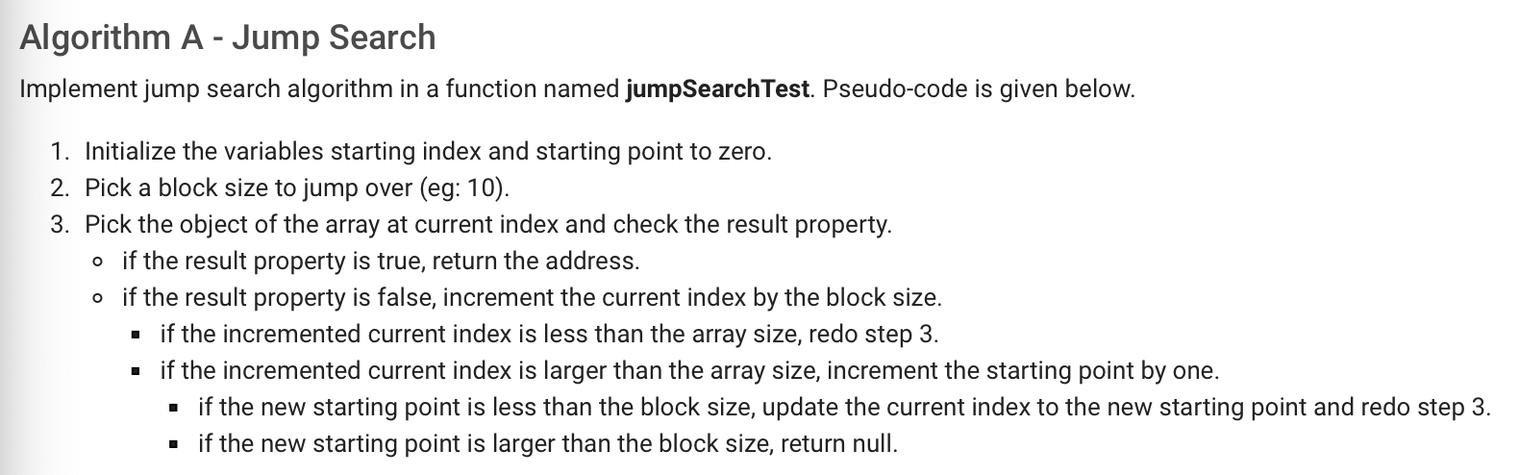

Slide 13
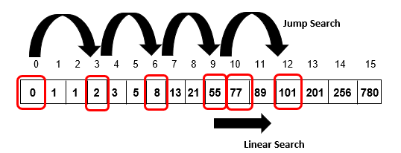

Slide 14
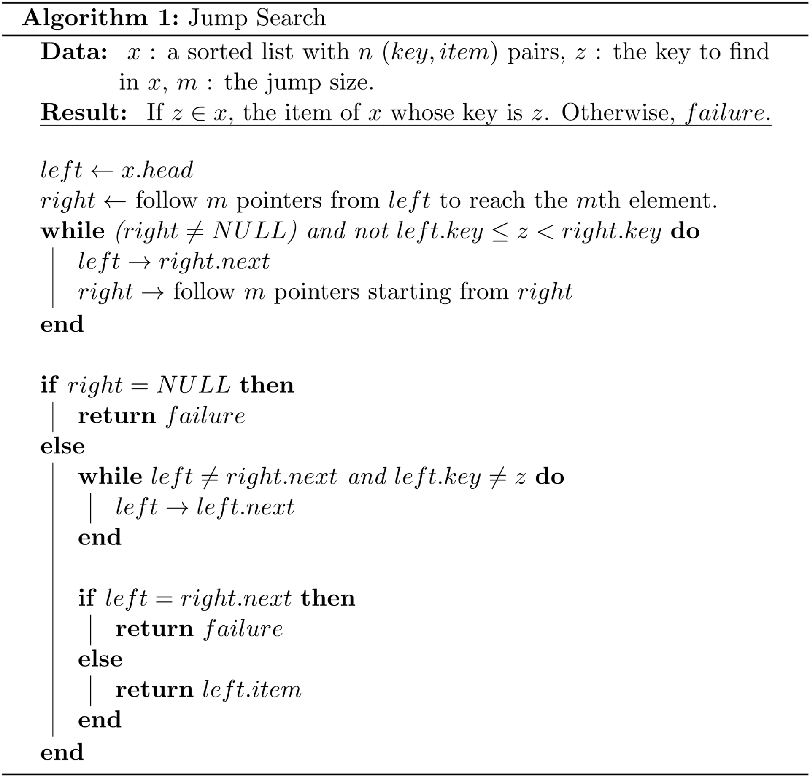

Slide 15
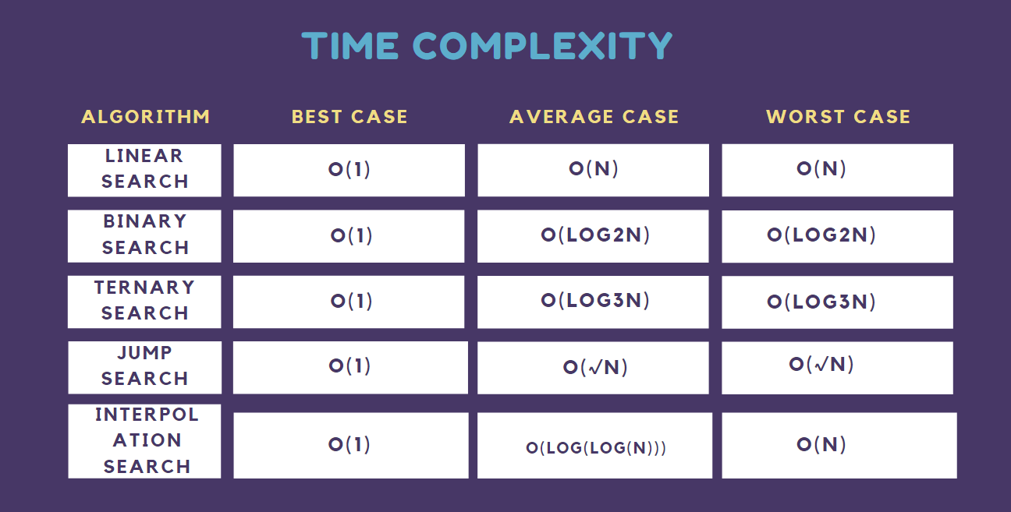

Slide 16
Thank you

